Slide 1


Telecom Customer Churn Analysis
Team Name :G3
Student Name : Hana Abdo Ahmed
Hamdy Mohamed Elsaid
Raef Nashed Ebaid
Sara Madgy Ahmed

Slide 2


Introduction
Problem Statement
The telecom company is experiencing customer churn, which leads to revenue loss and reduced customer loyalty.
The company wants to identify the main reasons behind customer churn and determine which customer segments are at the highest risk.
Our analysis helps the company make data-driven decisions to improve customer retention.

Slide 3
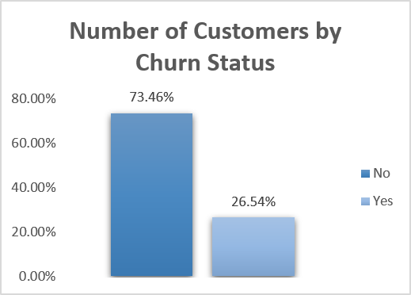
Problem Impact
Customer churn negatively affects the company by:
Reducing revenue
Increasing marketing costs
Losing loyal customers
Reducing business growth
then 73.46% of customers did not churn
26.54% of customers churned

Slide 4
Project Objectives
Our project aims to:
Understand why customers churn.
Identify high-risk customer segments.
Analyze customer behavior.
Recommend strategies to improve customer retention.

Slide 5
Exploration
Objective
Understand the dataset structure and customer information.
Explore the overall churn distribution.
Review key customer attributes before analysis.
What We Explored
Dataset size and features.
Data types.
Missing values and duplicates.
Distribution of the target variable (Churn).
Key variables such as Contract, Payment Method, Internet Service, and Tenure.

Slide 6
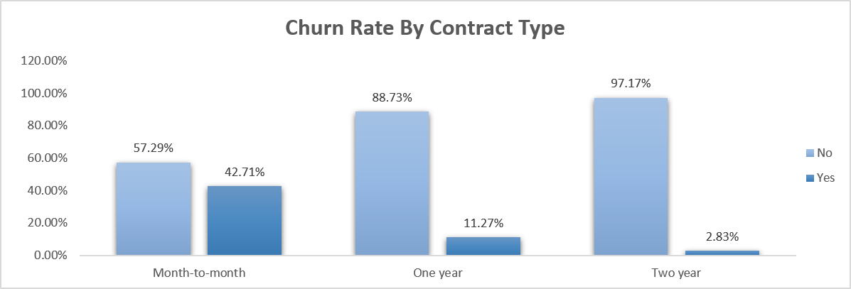
Business Questions
Insight
Short-term contracts are associated with higher customer churn.
Solution
Offer discounts and loyalty rewards to encourage customers to switch to long-term contracts.

Slide 7
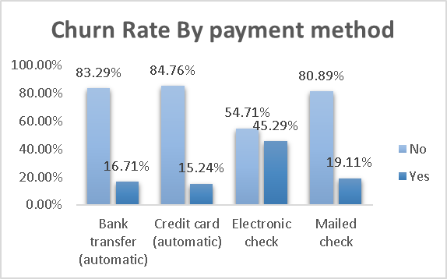
Insight
Customers using Electronic Check churn more than other payment methods.
Solution
Encourage customers to use automatic payment methods by offering incentives.

Slide 8
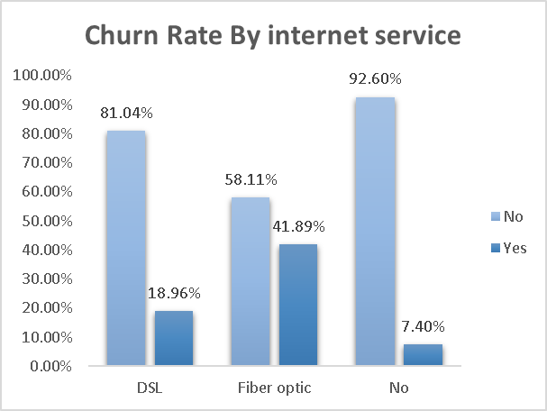
Insight
Fiber Optic customers have the highest churn rate.
Solution
Improve Fiber Optic service quality and investigate customer complaints.

Slide 9
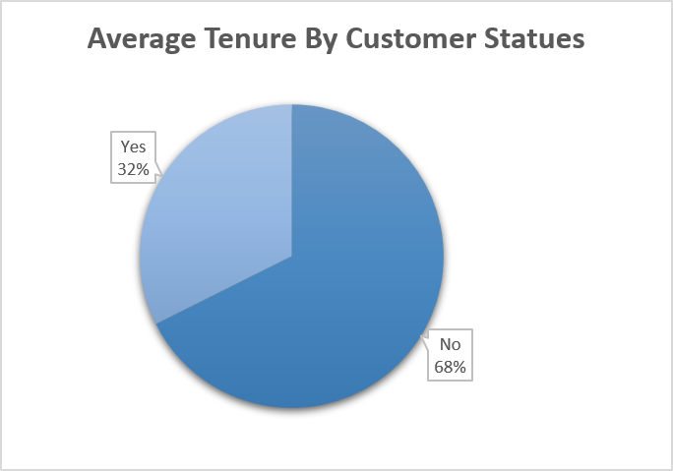
Insight
Customers who churn usually have a much shorter tenure than retained customers.
Solution
Focus retention campaigns on new customers during their first year.

Slide 10
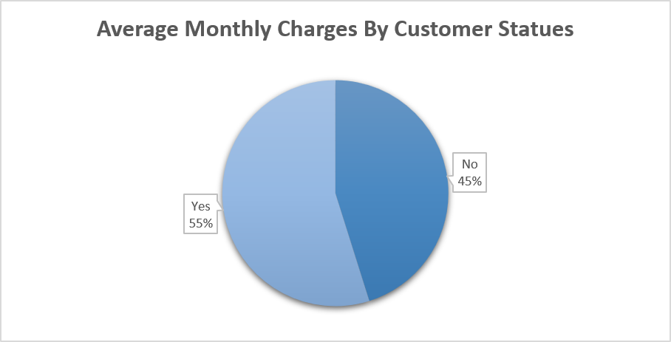
Insight
Churned customers pay higher monthly charges on average than retained customers.
Solution
Offer personalized discounts or suitable pricing plans for high-paying customers.

Slide 11
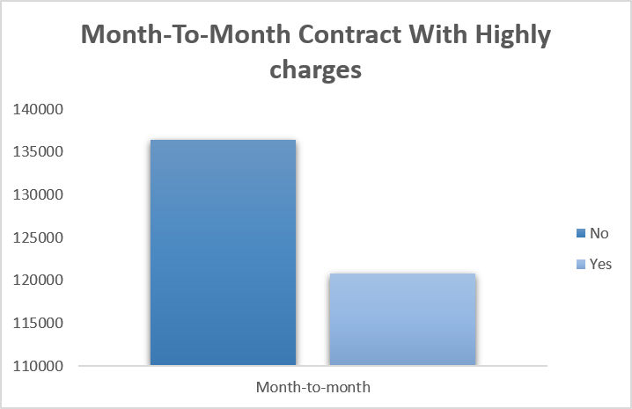
Business Insight
Customers with month-to-month contracts and high monthly charges represent an important customer segment to monitor, as short-term contracts combined with higher costs may increase the likelihood of churn.
Solution
Provide special offers or contract upgrades for this high-risk customer segment.

Slide 12
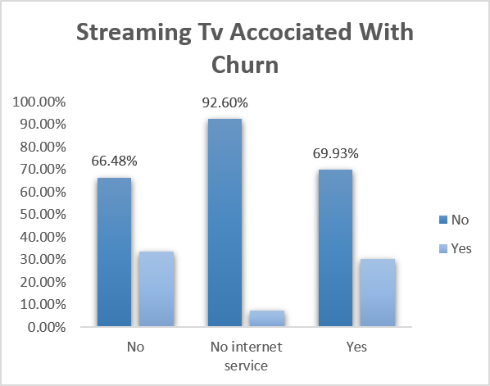
Insight
Streaming TV has a weak relationship with churn, as churn rates are similar for customers with and without the service.
Solution
The company should focus on improving more influential services rather than relying on Streaming TV to reduce churn.

Slide 13
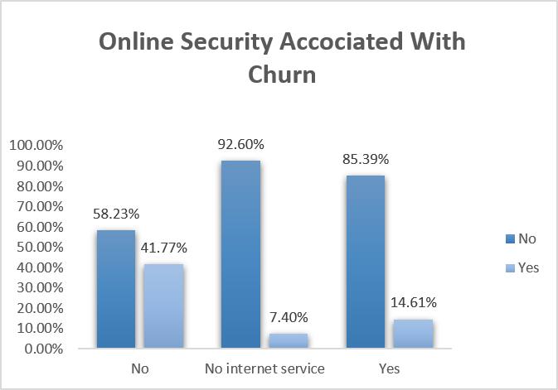
Insight
Customers without Online Security are more likely to churn than those who subscribe to the service.
Solution
Encourage customers to subscribe to Online Security by offering discounts or bundled packages.

Slide 14
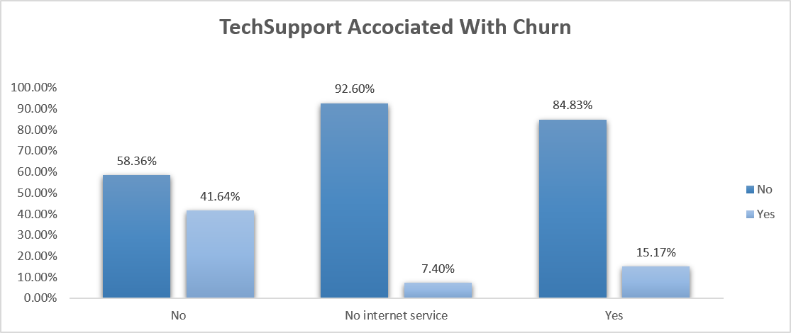
Insight
Customers without Tech Support show a significantly higher churn rate.
Solution
Improve technical support services and offer free support for new customers.

Slide 15
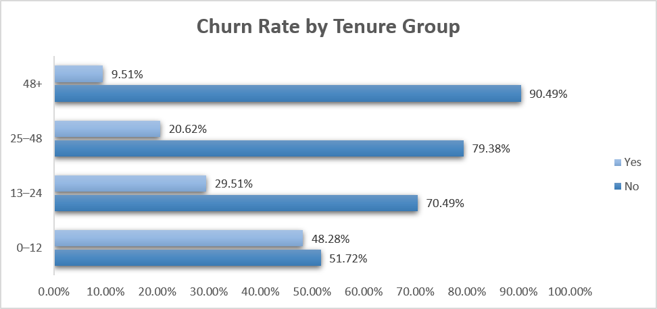
Diagnostic Analytics
Insight
Customers with shorter tenure (0–12 months) have the highest churn rate. As customer tenure increases, the churn rate decreases, indicating that new customers are more likely to leave.
Solution
Strengthen onboarding programs and engage new customers early.

Slide 16
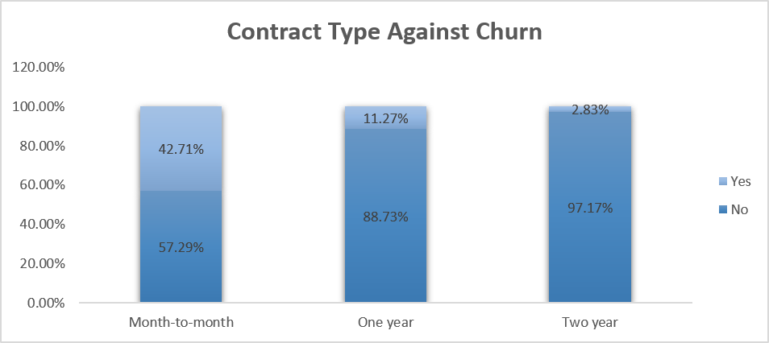
Insight
Month-to-month customers using Electronic Check show the highest churn.
Solution
Target this customer segment with personalized retention offers and encourage alternative payment methods.

Slide 17
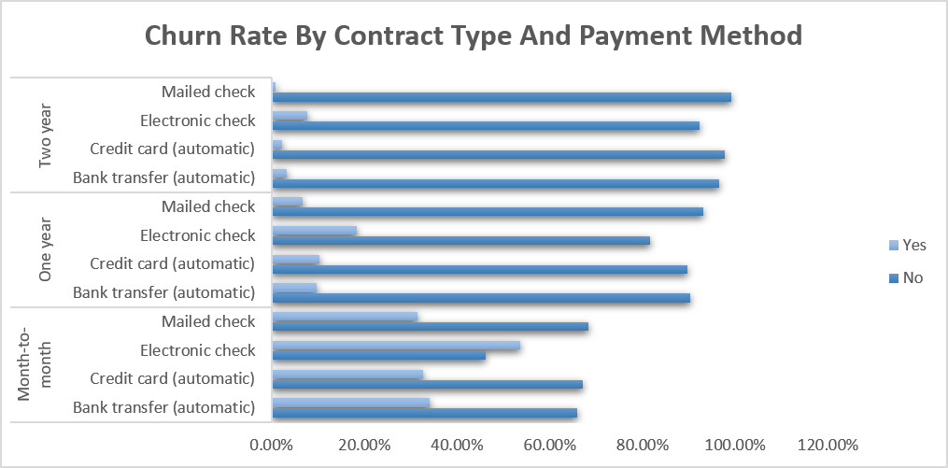
Insight
The highest-risk customers combine month-to-month contracts, electronic check payments, and high monthly charges.
Solution
Prioritize this segment in retention campaigns with tailored promotions and support.

Slide 18
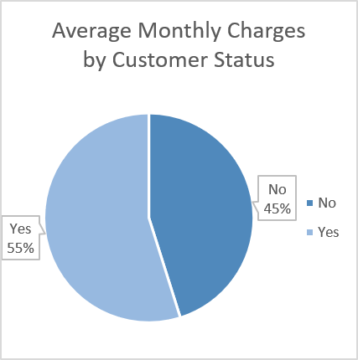

Insight
Customers with higher monthly charges are more likely to churn.
Solution
Review pricing strategies and provide flexible plans for customers with high monthly charges.

Slide 19
Challenges
Cleaning missing and inconsistent data.
Converting data types correctly.
Identifying the key drivers of customer churn.
Selecting the most appropriate visualizations.

Slide 20
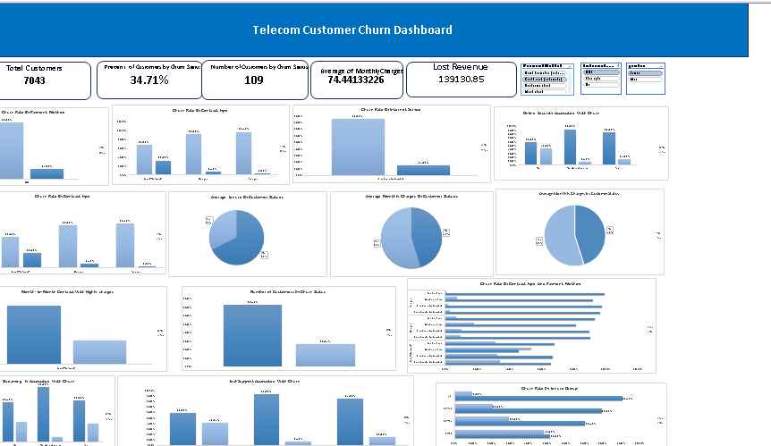

Slide 21
Conclusion
Our analysis showed that customer churn is mainly influenced by contract type, payment method, internet service, monthly charges, and customer tenure. Customers with month-to-month contracts, Fiber Optic internet, Electronic Check payments, and higher monthly charges were more likely to churn. By focusing retention efforts on these high-risk customers, the company can reduce churn and improve customer loyalty.

Slide 22

Thank You
Questions ?

